Slide 1

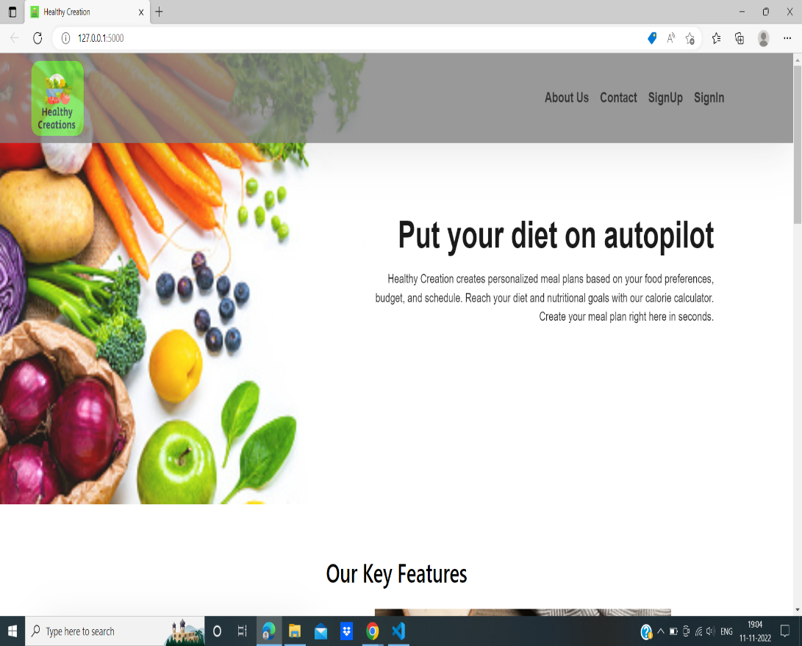
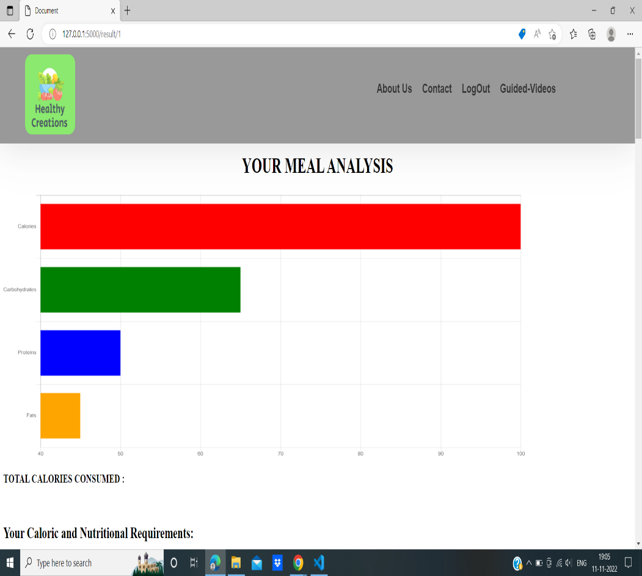
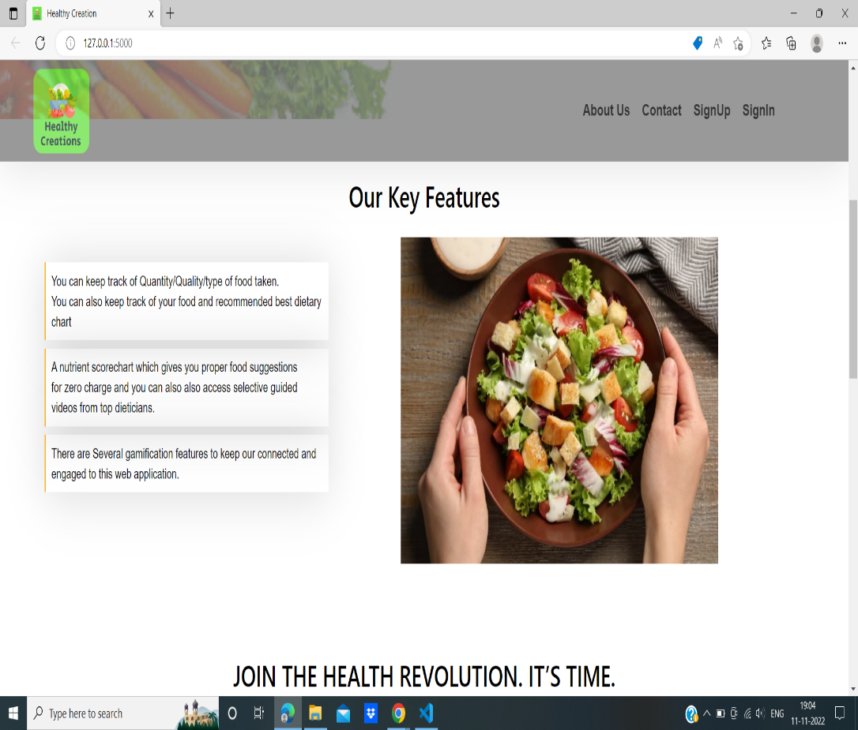
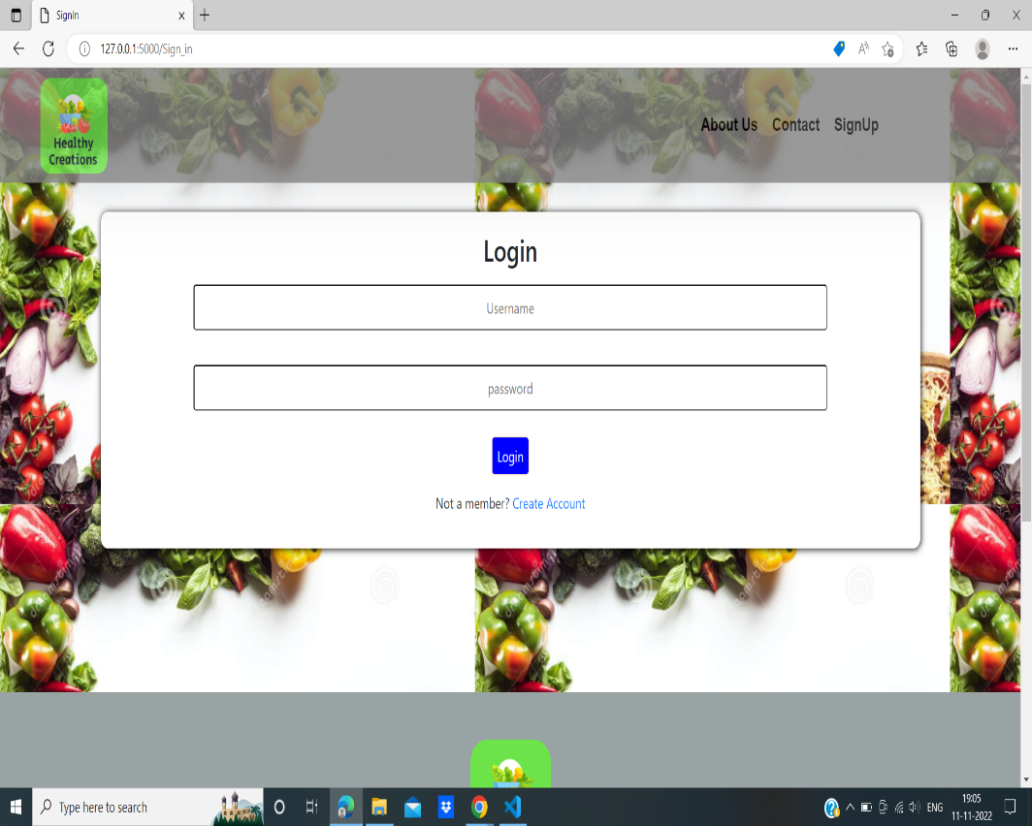
Acropolis Institute of Technology and Research
CALORIE ANALYSIS AND DIET TRACKING
Anurag Mahajan, Anushka Bhanpiya, Aryan Tapkire, Avani Jain
INTRODUCTION
INTERFACE
INTERFACE
CONCLUSIONS
Health professionals encourage the consumption of fruits and vegetables in our daily diet. Fruits are low in fat
and are attractive options as part of a nutritionally balanced diet. Their volatiles are rich in pleasing ester notes, and their simple sugars are often well balanced with organic acids offering characteristic flavors. In addition to providing simple sugars, vitamins, minerals, and dietary fiber, fruits contain a number of bio actives, notably polyphenolics, which have supported health benefits. The application tracks a user’s whole day consumption of food and accordingly determines the food suggestions based on his proteins, fats and carbs intake. The application in subject, provides a means for keeping a check on a person's daily eating habits by providing
calorie intake information as well as the food suggestions and timely food reminders of what a person can
consume as per his current physical needs.
Thus this application will help to provide users a detailed understanding of their daily diet and the changes that are required to maintain a healthy diet. It will be easier for users to get a hold of alternatives for their food habits while also maintaining the level of nutrition.This application fulfills that requirement of a user. This application will help a lot of users to maintain a healthy lifestyle as the app will take care of how much the user eats and what he/she should be eating for a balanced food intake.
REFERENCES
[1] Diet And Nutritional Status Of The Older Adults In Rural India - Scientific Figure on Research Gate.
Available from:
https://www.researchgate.net/figure/In-adequate-70-of-RDI-intake-of-various-nutrients-by-gender_tbl1_311809195 [accessed 12 Sep, 2022]
[2]TRUE Consortium. Recommended standards for assessing blood pressure in human research where blood pressure or hypertension is a major focus. J Clin Hypertens (Greenwich). 2017; 19(2):108‐113. 10.1111/jch.12948. [PMC free article] [PubMed] [CrossRef] [Google Scholar]
SCOPE
People are increasingly becoming diet conscious and they require a dietician to help them keep a track of their daily eating habits. This Web application works as a substitute to that. Users can now themselves find out what is missing from their diets and what they should be eating with the help of this app. Thus this application serves as an alternative to the dietician by providing necessary food suggestions as per the user’s whole day calorie intake and as per his current physical parameters
OBJECTIVES
1.Web Application to keep track of Quantity/Quality/type of food taken. Build smart food analyzer Application that allows user to keep track of their food and also recommend best dietary chart .
2.A nutrient score chart which gives user proper food suggestions for zero charge and it also comes with selective guided videos from top dieticians.
OUTCOMES
CONTACT
1. This application provides the complete information regarding calorie intake of the user as per the the user-consumed and user-entered food items for the day considering all the factors namely the physical parameters of the user that are height, weight , age .
2.Thus this application will help to provide users a detailed understanding of their daily dietand the changes that are required to maintain a healthy diet.
Anurag Mahajan
anuragmahajan20495@acropolis.in
Anushka Bhanpiya -
anushkabhanpiya20427@acropolis.in
Aryan Tapkire -
aryantapkire20455@acropolis.in
Avani Jain-
avnijain2858@acropolis.in
RESEARCH POSTER PRESENTATION DESIGN © 2022
www.PosterPresentations.com

